Slide 1
GSoC -2021
Project – “Thermonuclear Supernova Classification
via their Nuclear Signatures”
- Vidit Ostwal

Slide 2
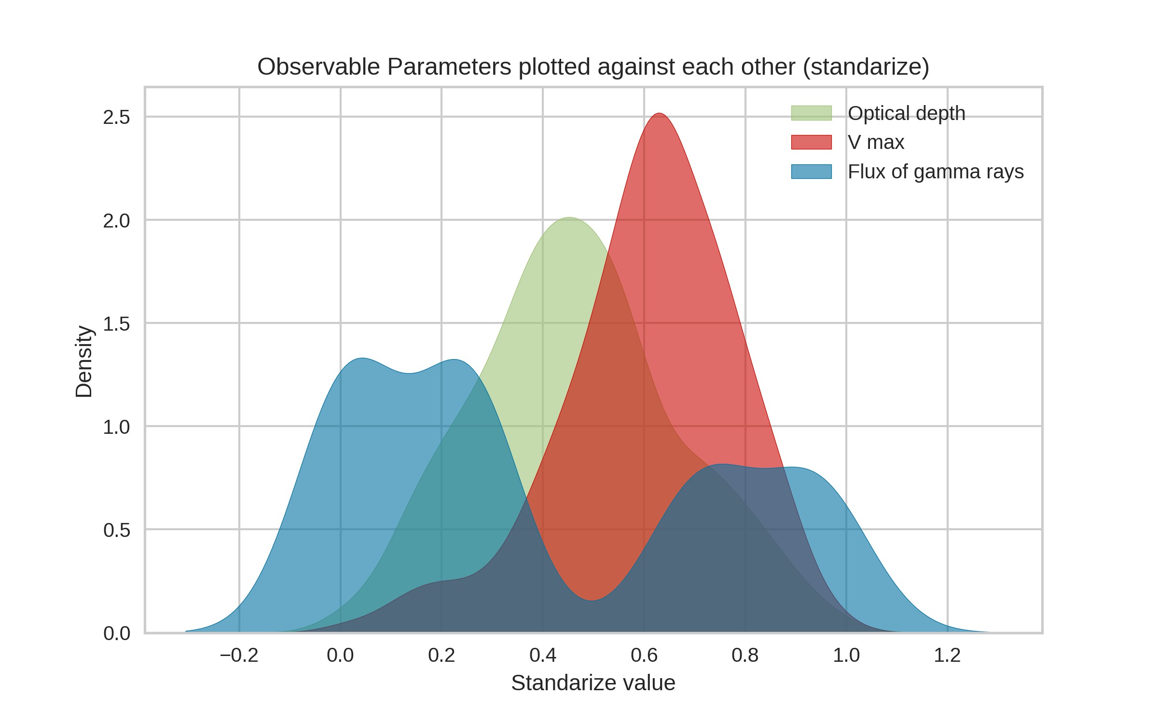
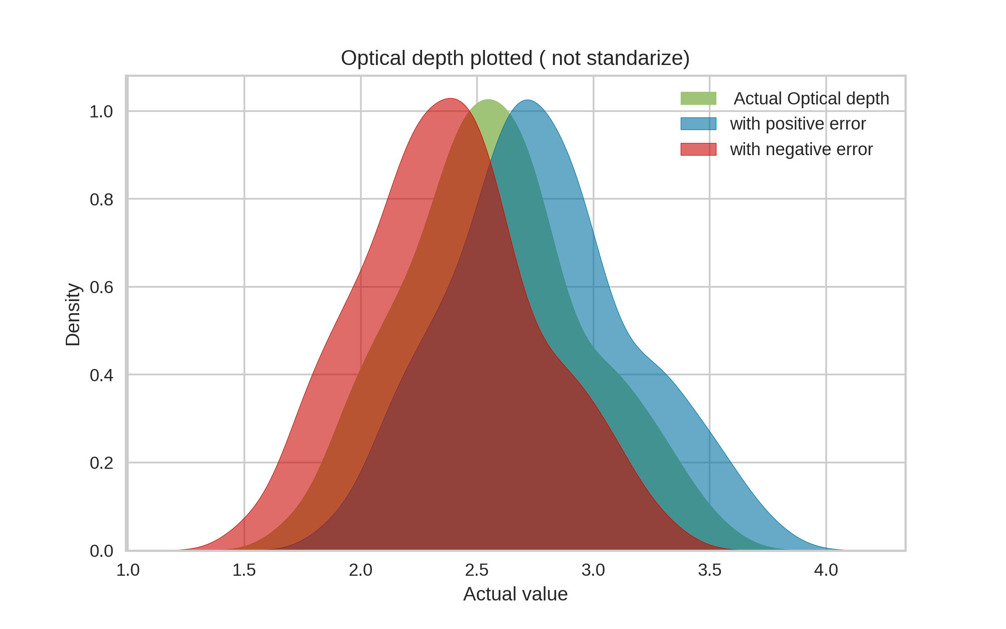
The data was standardize (X – Xmin)/(Xmax – Xmin) before making this plot, kdeplot of seaborn (kernel density estimation) is used to make this plot.
Major observation that could be concluded:
The minimum of Flux of gamma rays occurs between the maximum of both optical depth and maximum velocity
The peak of maximum velocity is highest as compared to the other physical parameters peak.
The optical depth is plotted with errors added and subtracted (values not standardize)
The peak (maximum density) of all the three graph remains the same which means that probability of finding in a pre- defined contour remains the same for all the three cases
The peak shifts leftwards or rightwards accounting whether the error are added or subtracted.

Slide 3
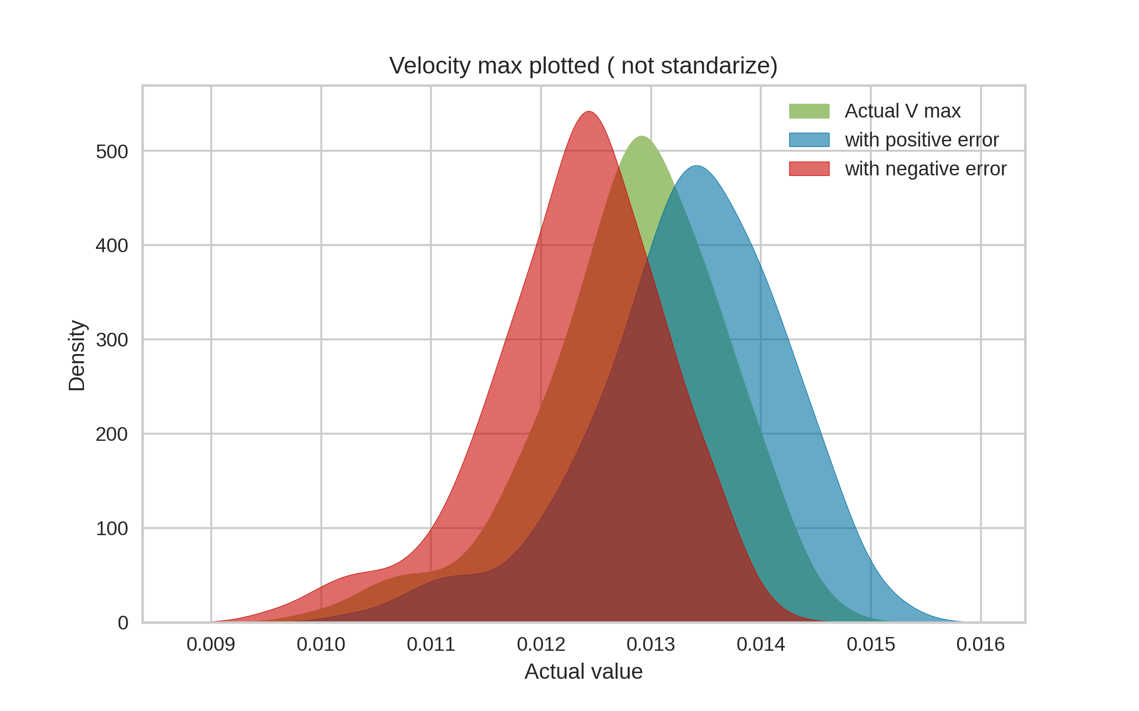
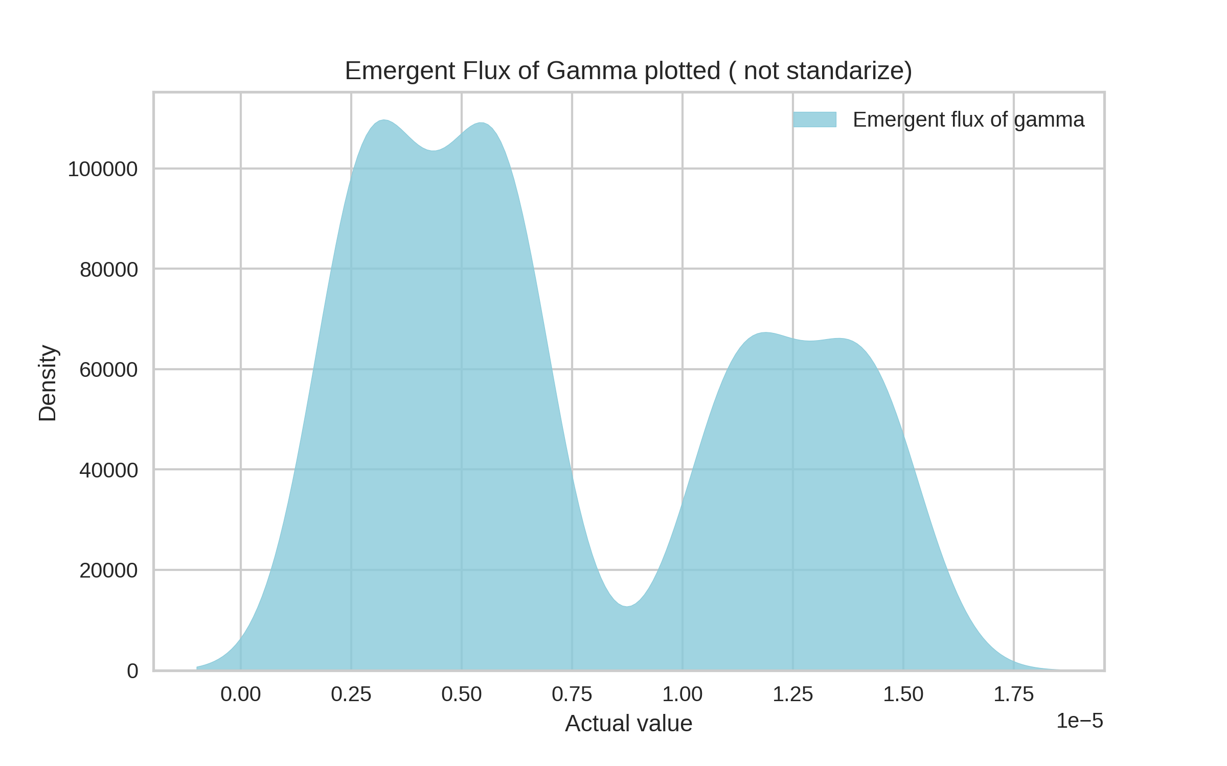
The maximum velocity is plotted with errors added and subtracted (values not standardize).
The peak (maximum density) of all the three graph does not remains the same which means that probability of finding in a pre- defined contour has changed and is maximum in a particular region when errors are subtracted
The peak shifts leftwards or rightwards accounting whether the error are added or subtracted.
Emergent Flux of Gamma is plotted
(values are not standardize)
It has two maxima with a minima occurring in between them.
The density value is quite high as compared to all the previous graph, accounting to the fact that certain region / contour has high number of points occurring in between them

Slide 4
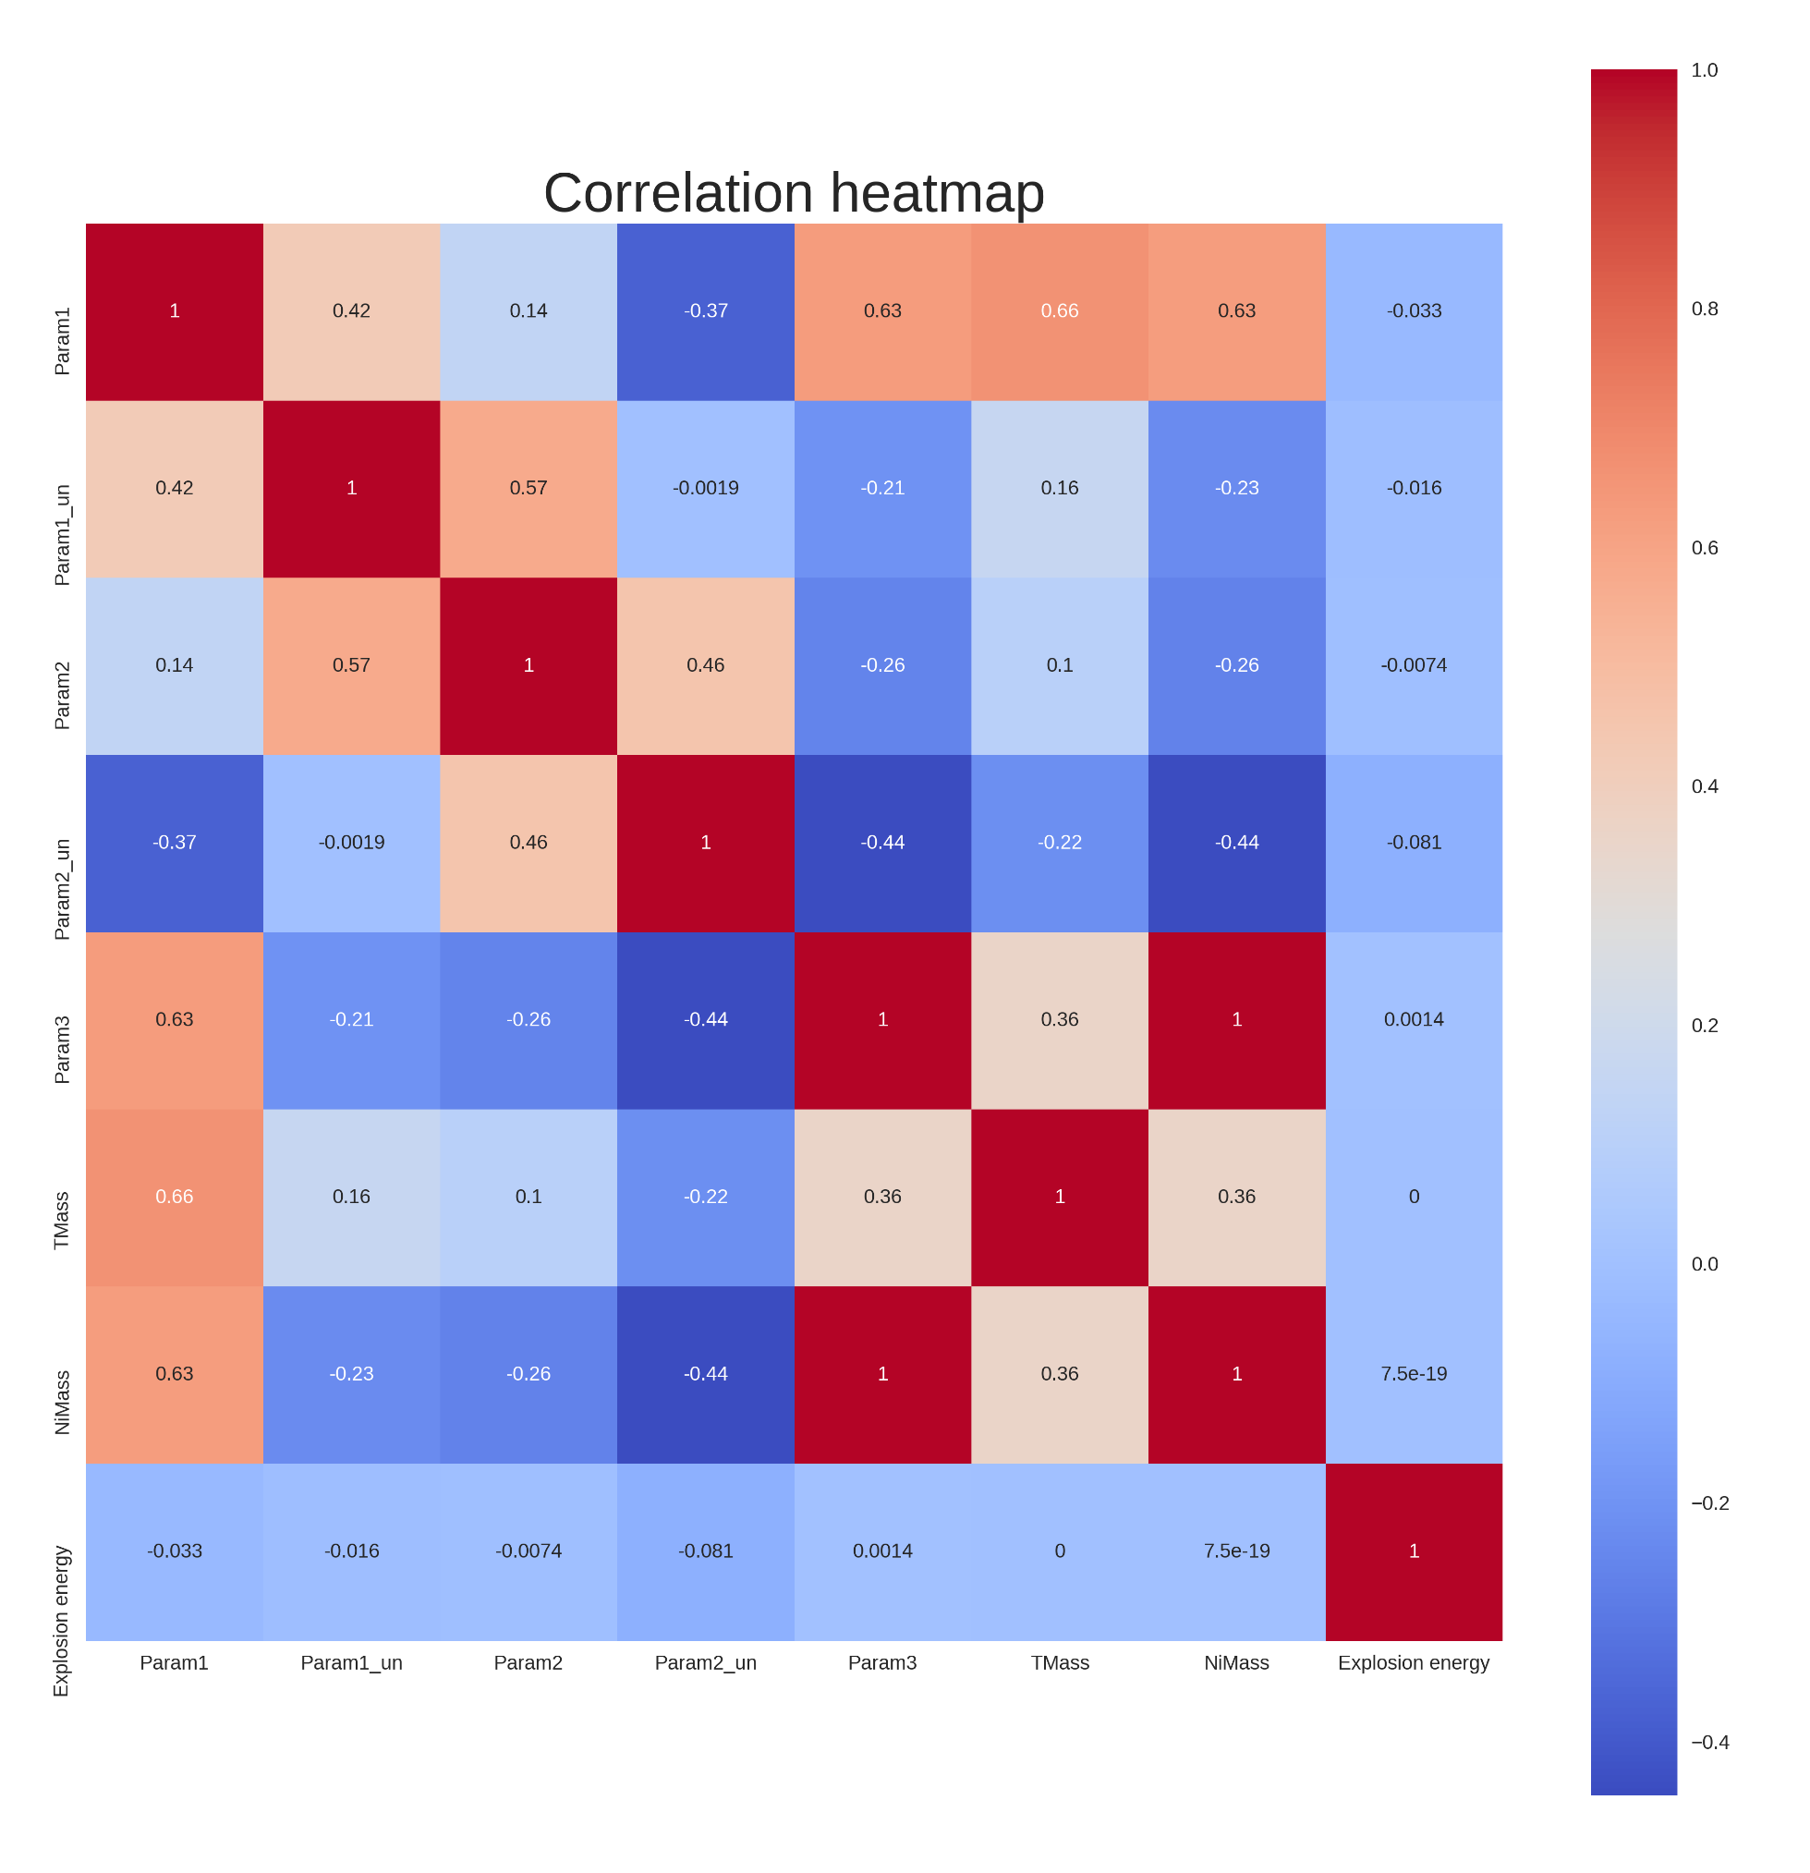
 | Param1 | Param1_un | Param2 | Param2_un | Param3 | TMass | NiMass | Explosion energy
Param1 | 1.000 | 0.419 | 0.139 | -0.373 | 0.632 | 0.663 | 0.627 | -0.033
Param1_un | 0.419 | 1.000 | 0.574 | -0.002 | -0.205 | 0.162 | -0.227 | -0.016
Param2 | 0.139 | 0.574 | 1.000 | 0.455 | -0.256 | 0.102 | -0.261 | -0.007
Param2_un | -0.373 | -0.002 | 0.455 | 1.000 | -0.445 | -0.218 | -0.441 | -0.081
Param3 | 0.632 | -0.205 | -0.256 | -0.445 | 1.000 | 0.357 | 0.999 | 0.001
TMass | 0.663 | 0.162 | 0.102 | -0.218 | 0.357 | 1.000 | 0.362 | 0.000
NiMass | 0.627 | -0.227 | -0.261 | -0.441 | 0.999 | 0.362 | 1.000 | 0.000
Explosion energy | -0.033 | -0.016 | -0.007 | -0.081 | 0.001 | 0.000 | 0.000 | 1.000
To identify the relationship between physical and observable parameters, correlation matrix and a heatmap is made with dark red = 1 and dark bule = -0.4.
Some major observation:
The uncertainty in optical density has correlation of 0.41 with value of optical density, thus value of uncertainty increases as optical density increases but not as rapidly, on the other hand uncertainty of maximum velocity has a correlation of -0.37 which means uncertainty decreases as maximum velocity increases.
Param1 and Param2 that is optical depth and maximum velocity are weakly positively correlated having a correlation of just 0.139.

Slide 5
Param1 and Param3 that is optical depth and emergent flux of gamma rays are fairly positively correlated having a correlation of 0.639.
Param2 and Param3 that is maximum velocity and emergent flux of gamma rays are weakly negatively correlated having a correlation of -0.256.
Optical depth (Param1) has a fairly positive correlation with Total Mass (correlation = 0.663), Ni Mass (correlation = 0.627) and weak negative correlation with Explosion energy (correlation = -0.033).
Maximum Velocity (Param2) has weak positive correlation with Total Mass (correlation = 0.102), and weak negative correlation with Ni Mass (correlation = -0.261) and with explosion energy (correlation = -0.007)
Emergent flux of gamma rays (Param3) has fairly positive correlation with Total Mass (correlation = 0.357), strong correlation with Ni Mass (correlation = 0.999) and a very weak correlation with explosion energy (correlation = 0.001).
Correlation of 0.999 suggests that the rate at which Ni mass increases/ decreases will be almost same as rate at which emergent gamma rays increase/ decreases.

Slide 6
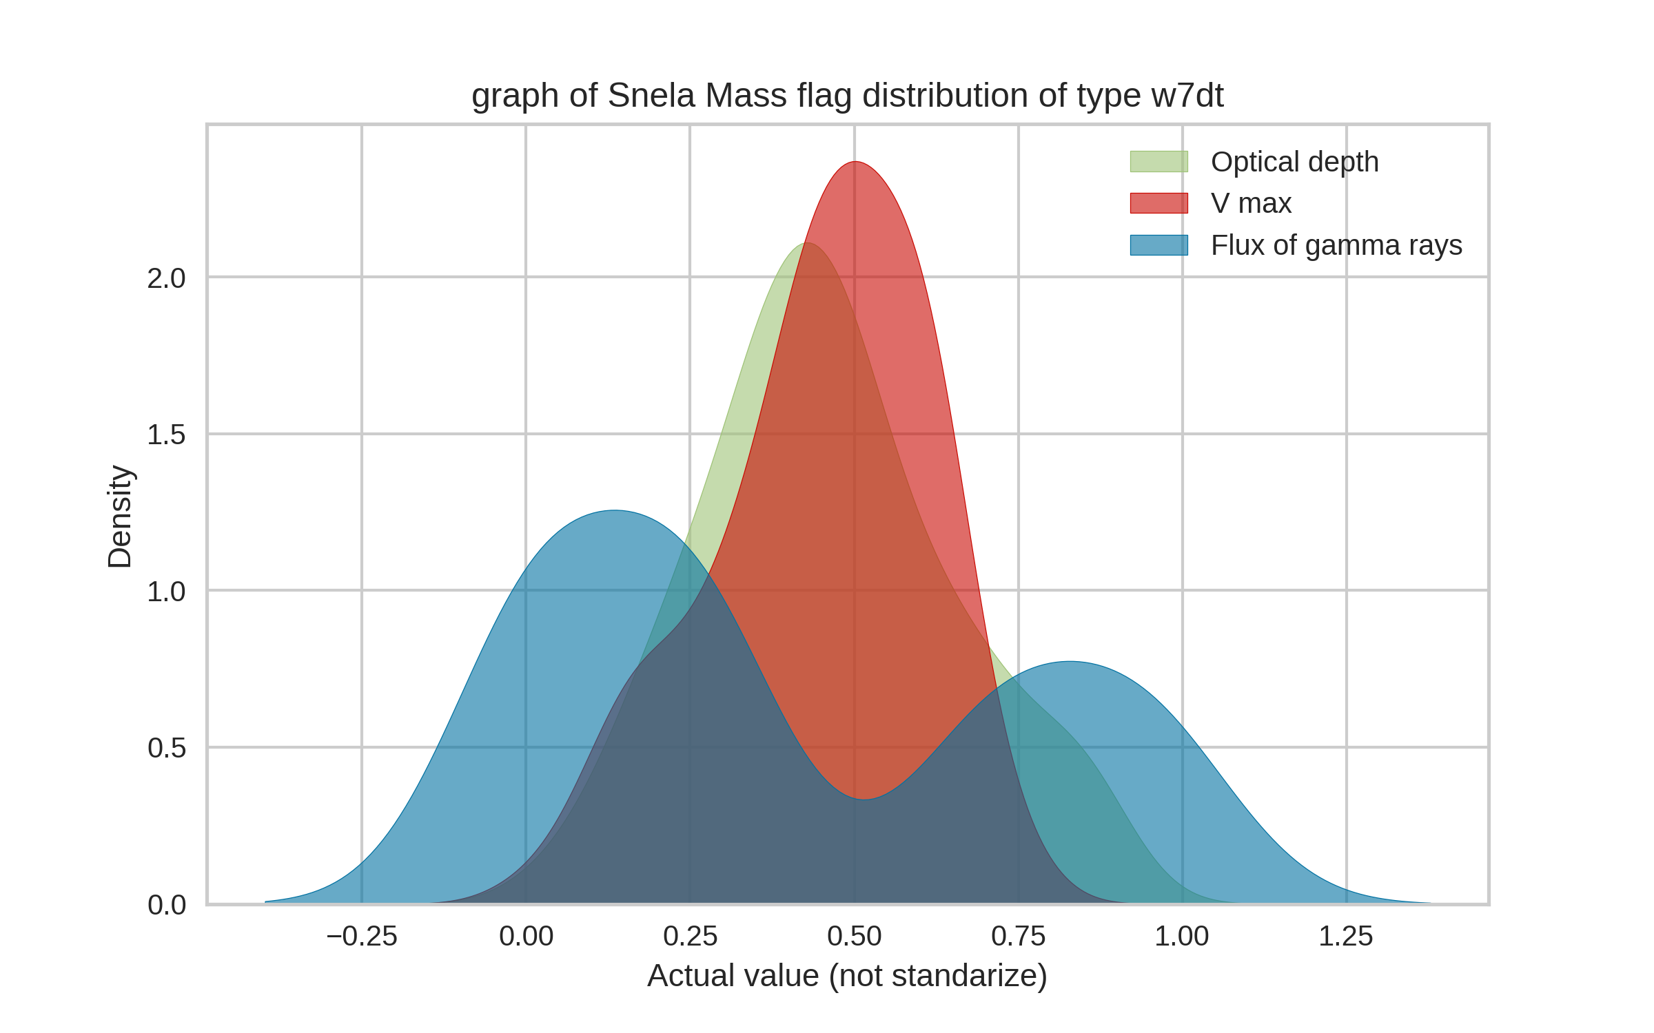
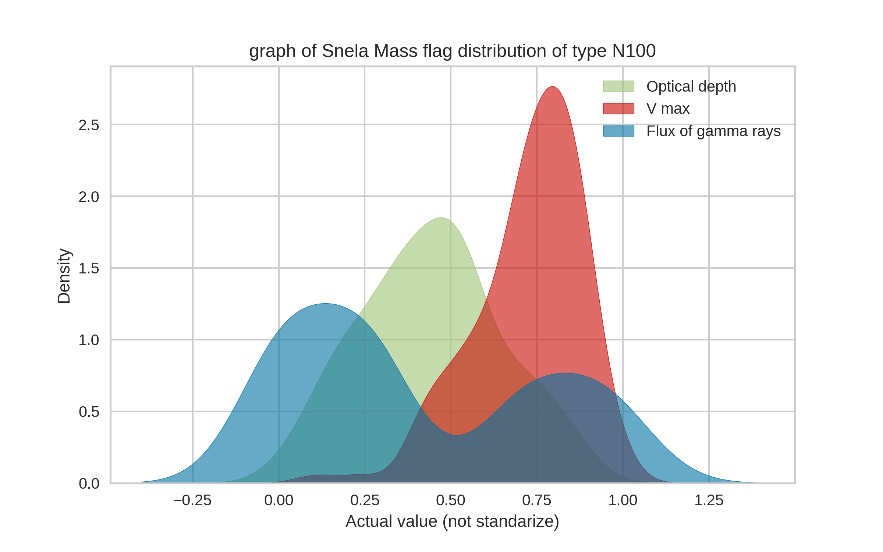
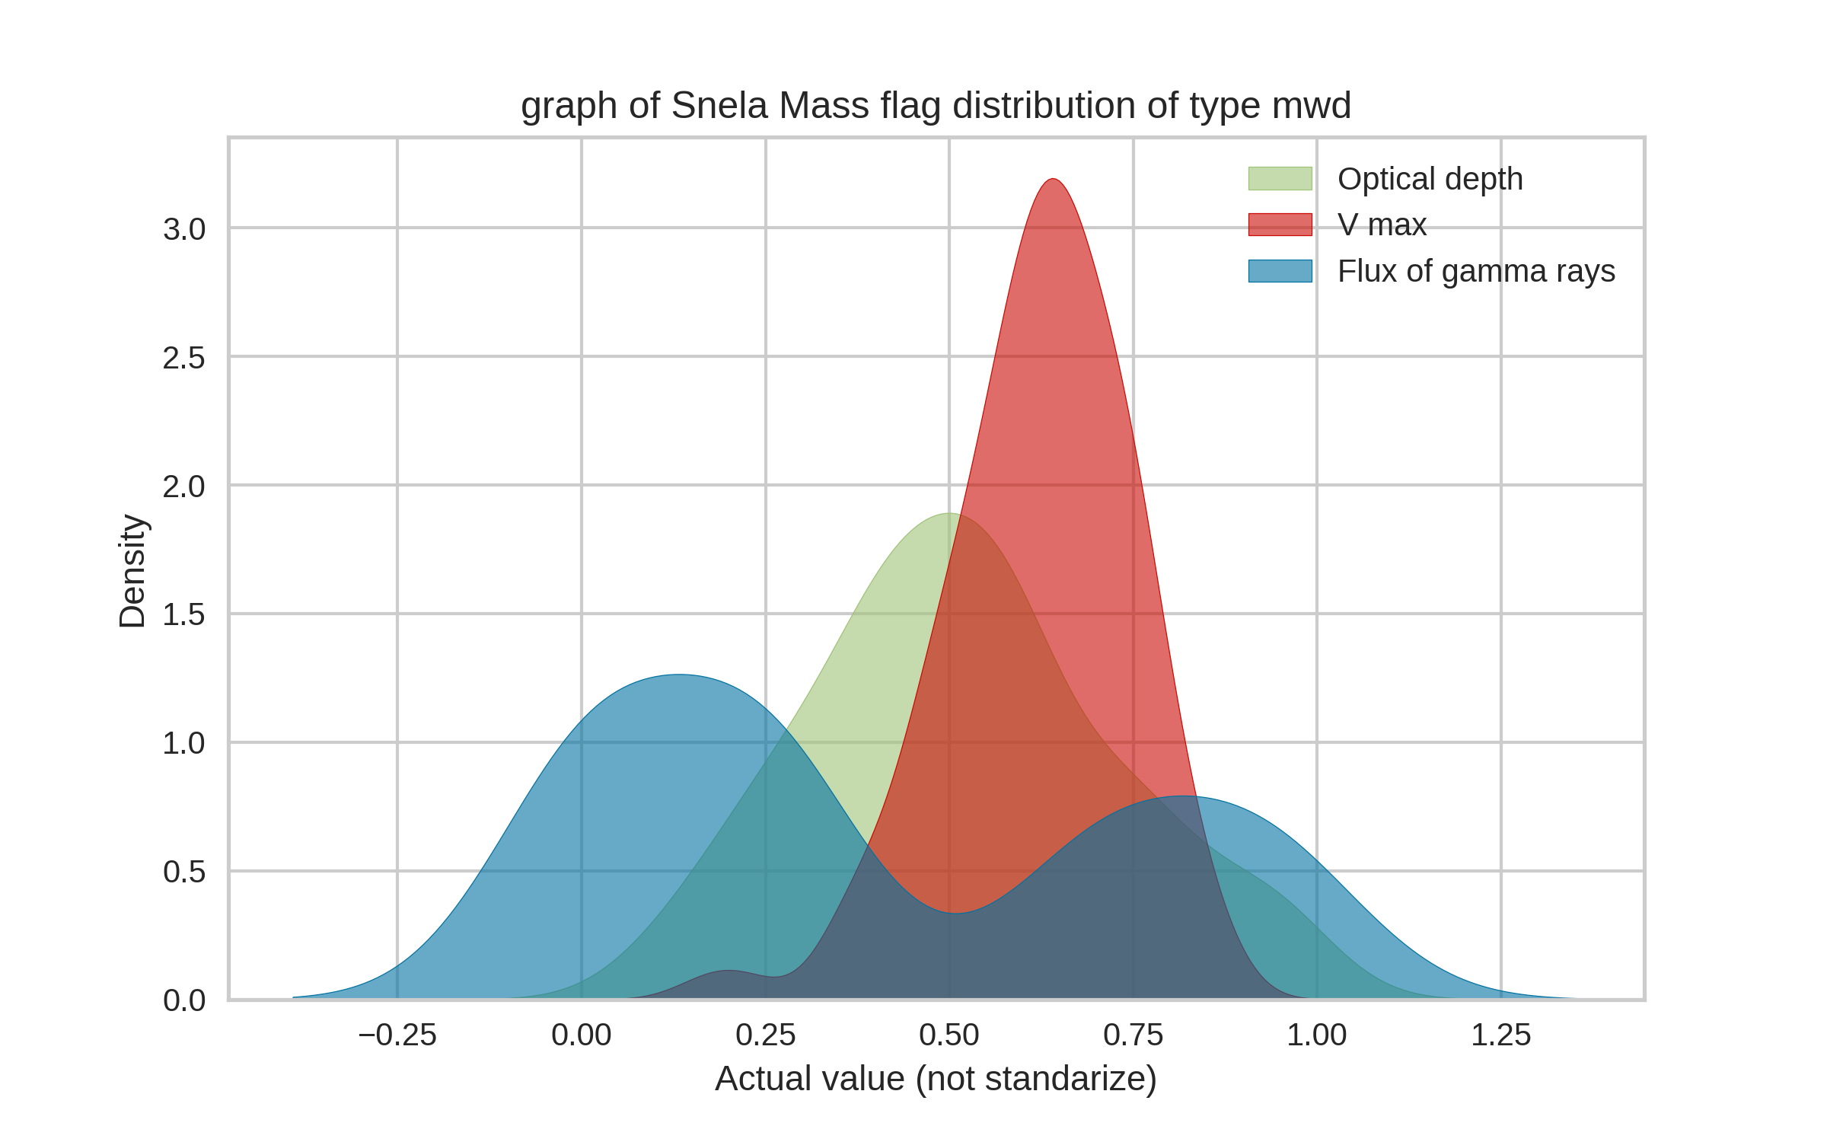
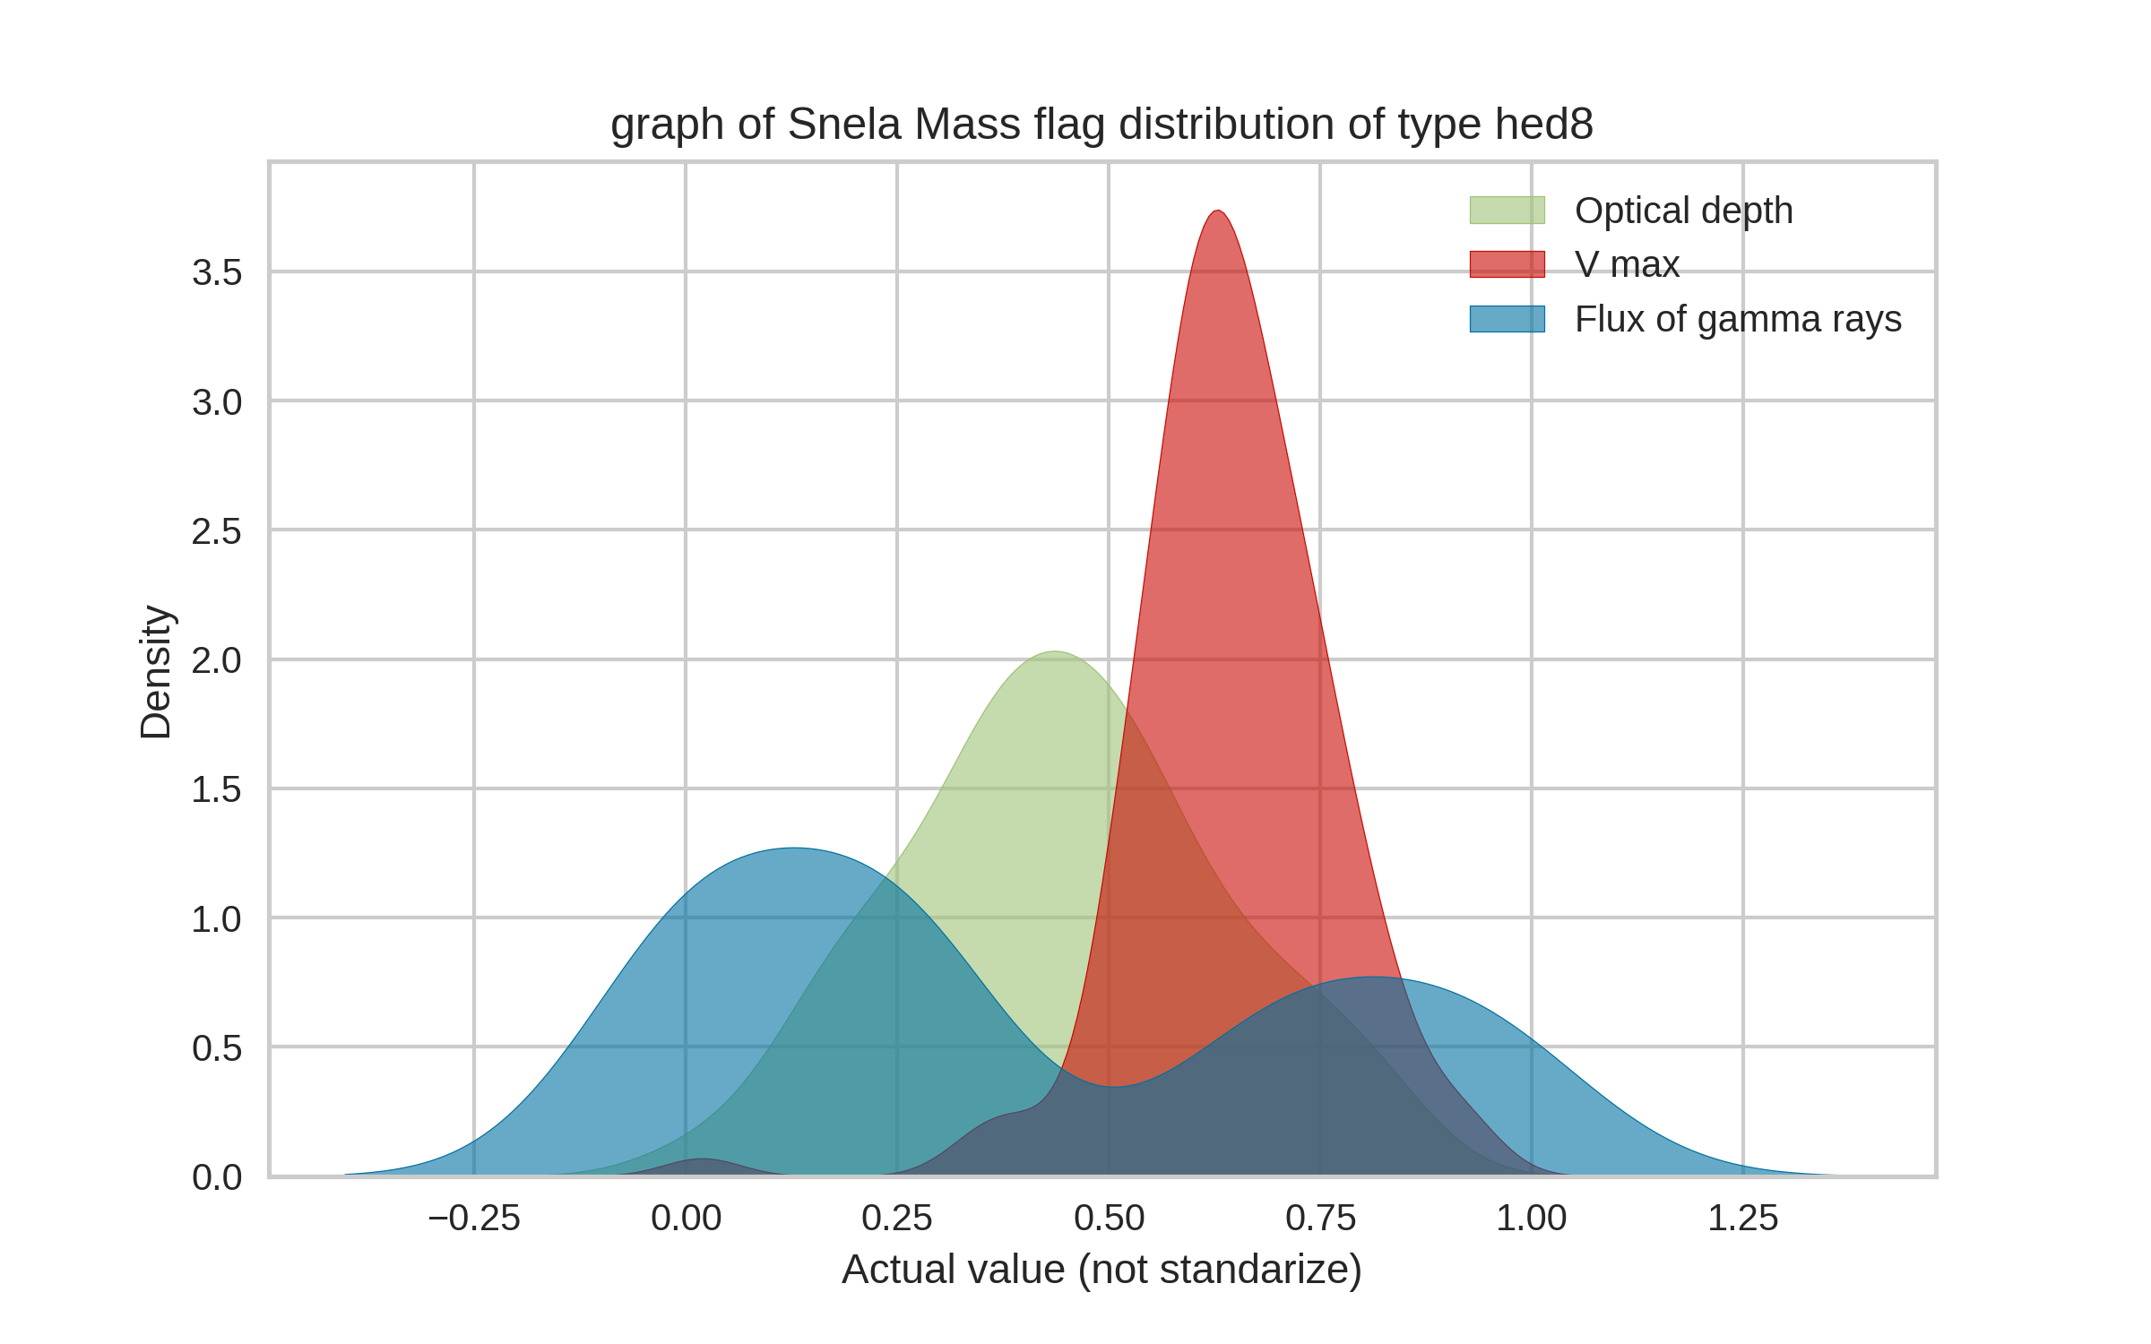
The different type of Snela Mass flag distribution were categorized and their observable parameters were plotted against each other

Slide 7
Some major observation which were made from the previous graphs:
The peak of maximum velocity is higher than the peak of optical density in all the plots.
The peak of maximum velocity when compared to the peak of optical depth is much higher in ‘N100’, ‘mwd’ and ‘hed8’ but this peak is comparable with the peak of optical depth in case of ‘w7dt’.
The peak of maximum velocity in case of ‘N100’, ‘mwd’ and ‘hed8’ is a little bit rightwards to the minima of emergent flux of gamma rays, while in case of ‘w7dt’ this peak is almost just above the minima of emergent flux of gamma rays.
CONCLUSION : ‘w7dt’ have somewhat distinguish quality in case of SNela Mass Distribution.

Slide 8
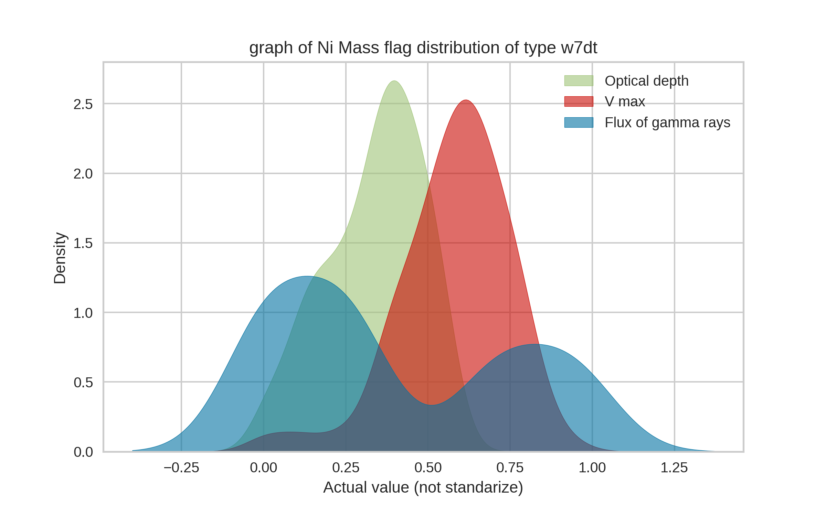
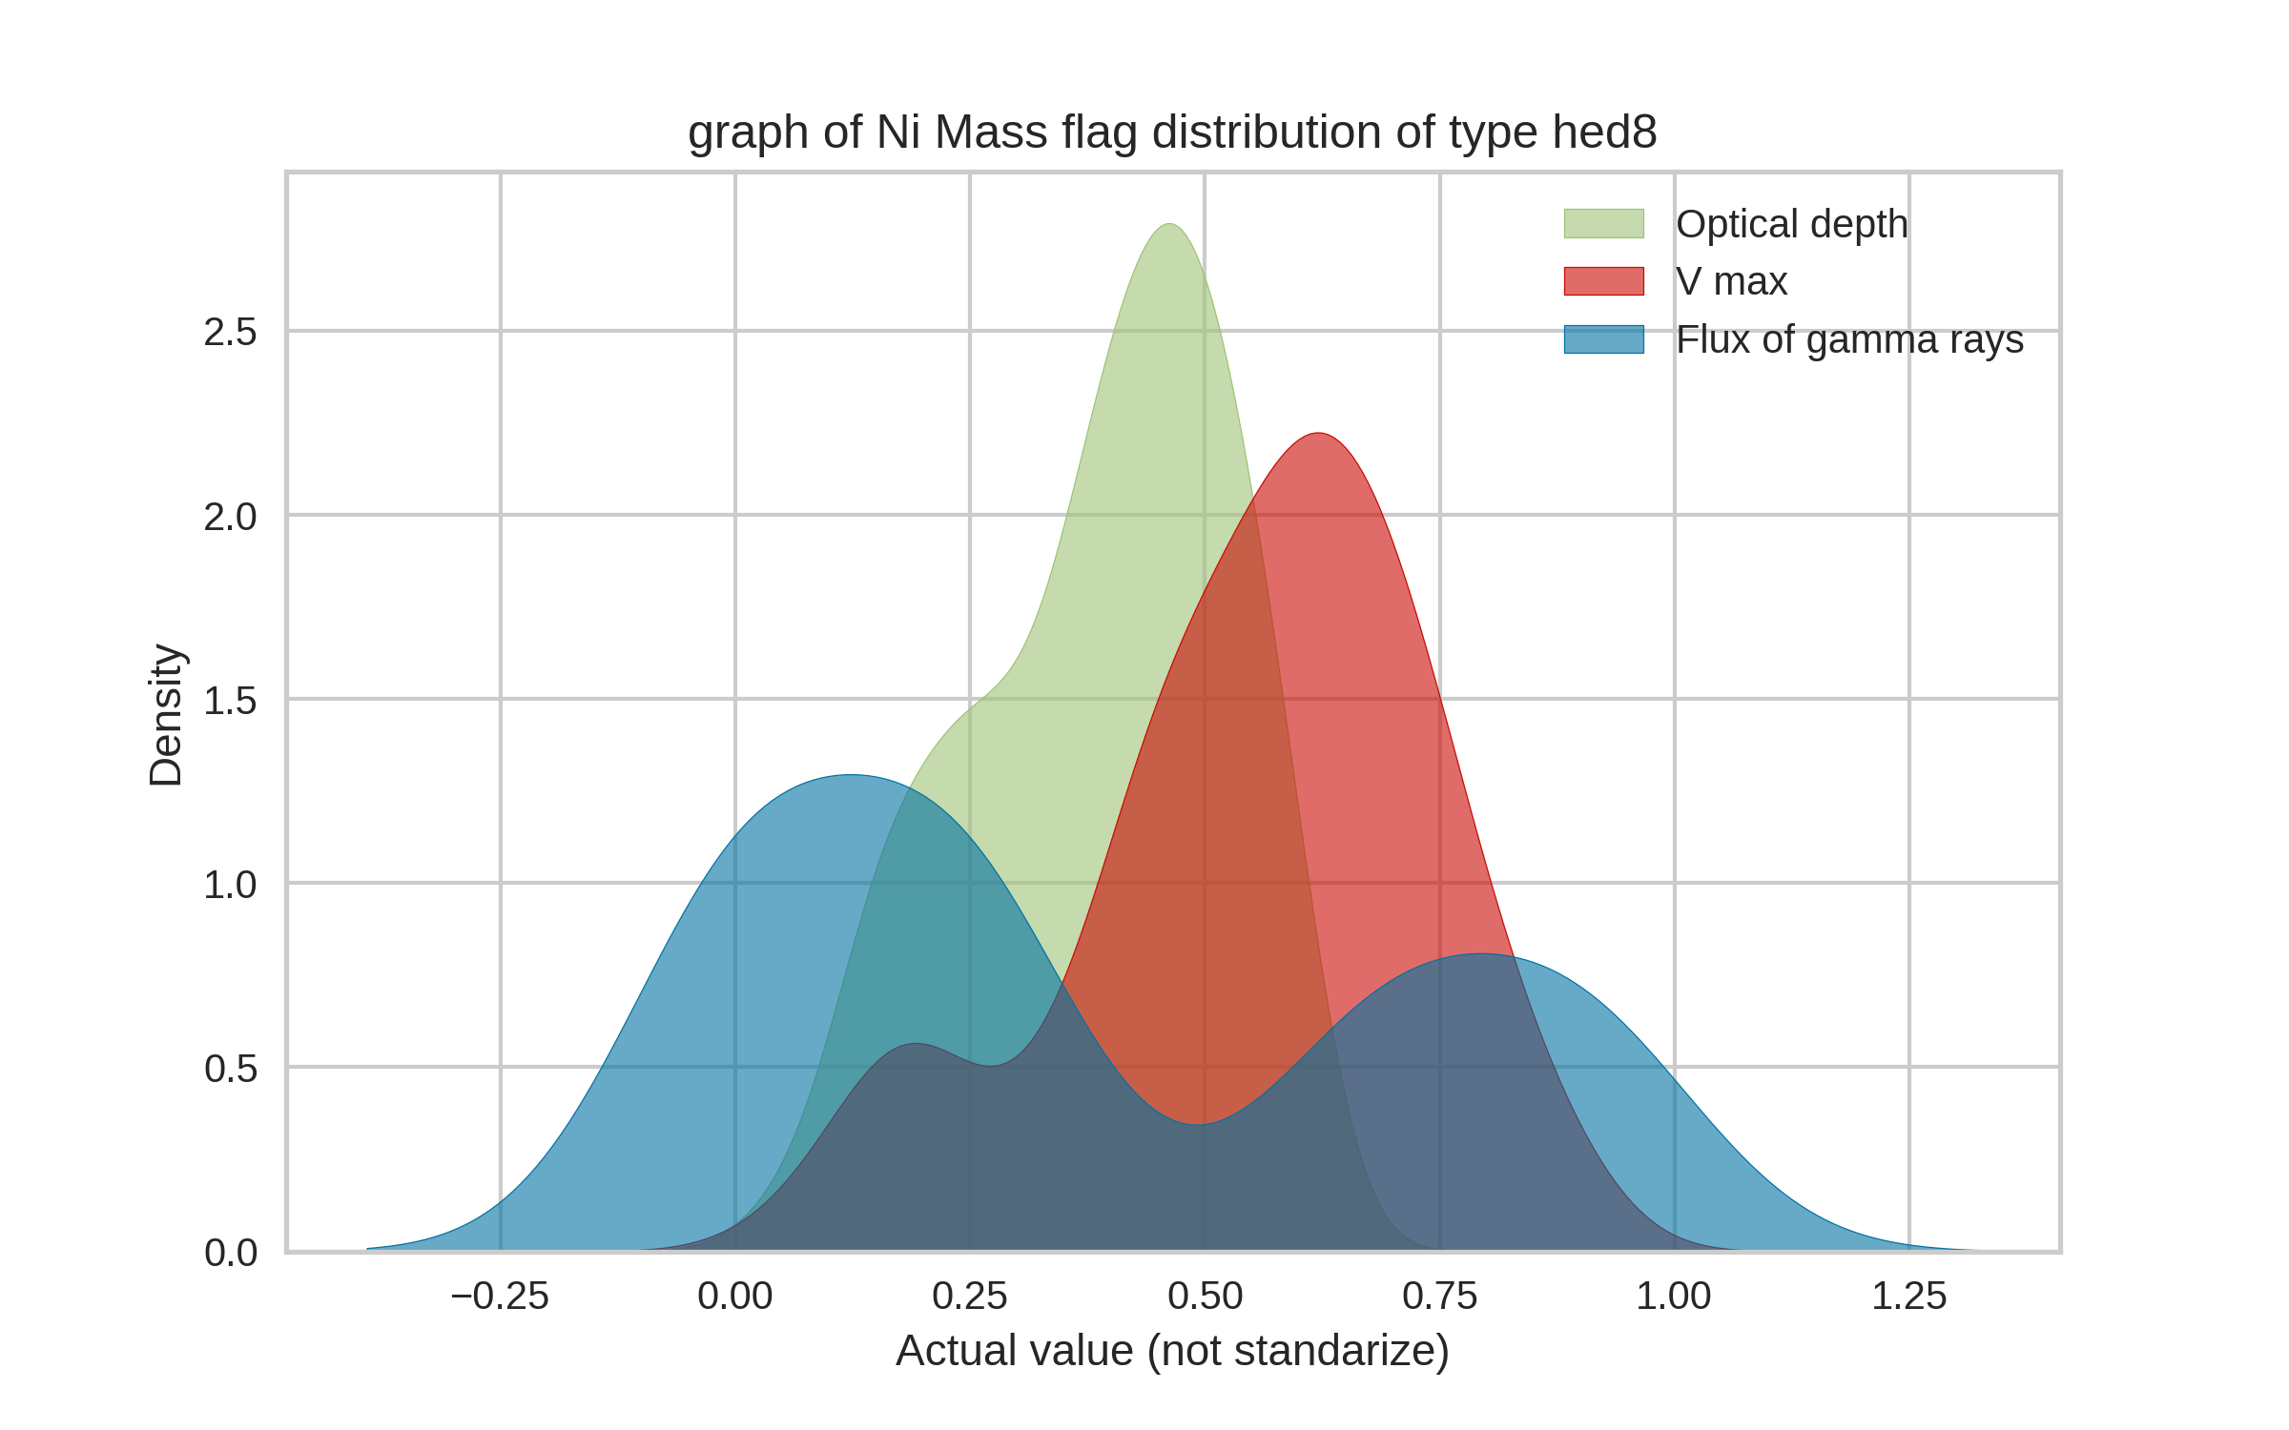
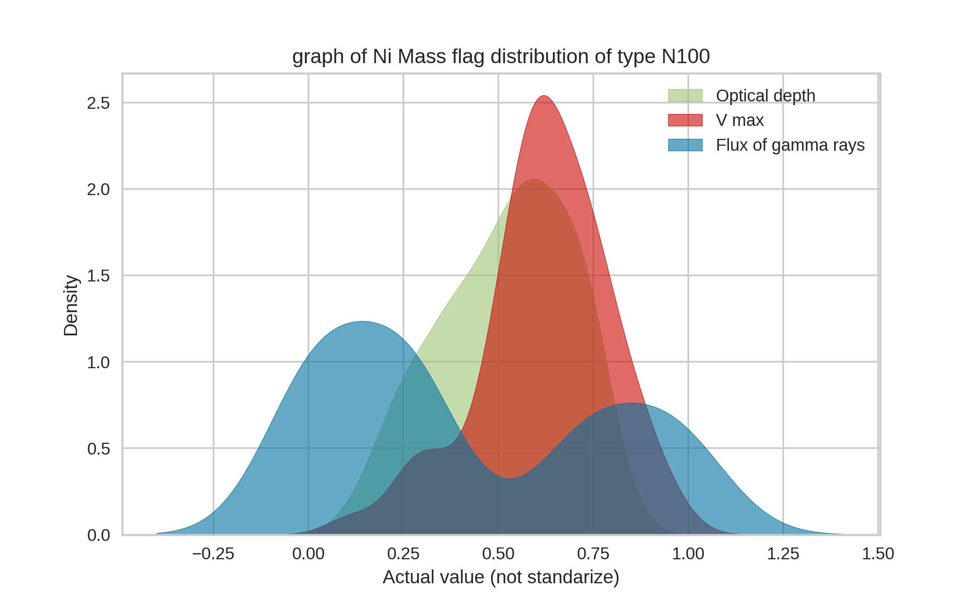
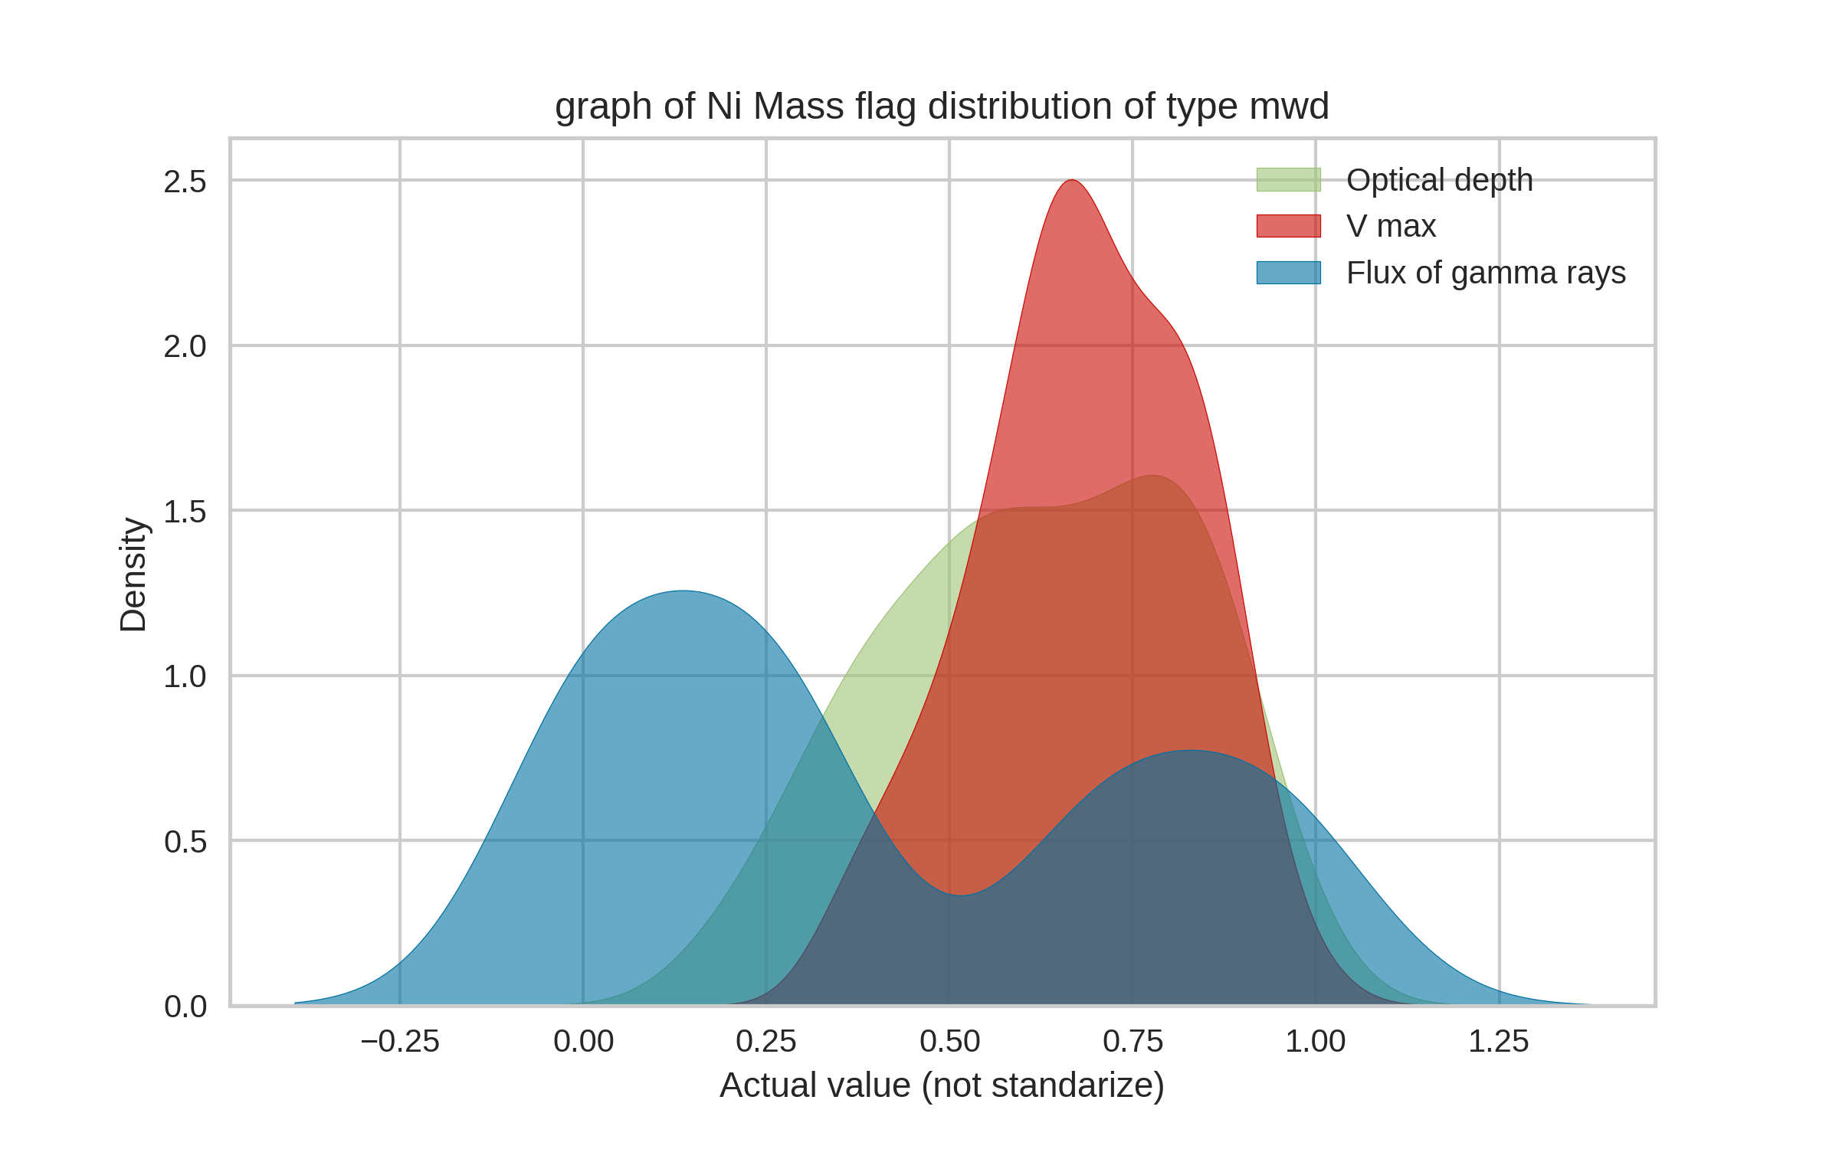
The different type of Initial Ni flag distribution were categorized and their observable parameters were plotted against each other

Slide 9
Some major observation which were made from the previous graphs:
The peak of maximum velocity is not higher than the peak of optical density in all the graph, as in case of SNela Mass Distribution.
The trend of higher peak can not be seen in the Initial Ni Mass Flag distribution when the type of flag distribution are ‘w7dt’ and ‘hed8’.
In ‘hed8’ the peak of optical density is much higher than the peak of the maximum velocity, whereas in ‘w7dt’ the peak of optical density is almost same as peak of maximum velocity.
CONCLUSION : These two group have distinguish quality, in both of them the peak of optical density is higher than the peak of maximum velocity.

Slide 10
For, this typical dataset, two different types of models are used,
Now, for the determination of Total Mass, Mass of Ni and Explosion Energy a linear regression model is used, a linear regression model is used as these values have a continuous domain, so any value in that particular domain can be achieved under desired observable parameters.
For each physical parameters determination a different model has been made.
To check the efficiency of the models MAE (mean absolute error) , MSE (mean squared error) ,R2 (R-squared) have been evaluated.
The dataset which is given to train the model is not been standardized and the uncertainty columns are been neglected.
Lasso and Ridge models should be avoided as these models are usually used when independent variable are around (12-15), and even when they were tried the alpha value really did not had a great effect on the prediction of the model.
For, the type of flag for Snela mass and Ni mass distribution, Random Forest Classifier has been used Random Forest Classifier has been used as it is a classification problem.
For each distribution flag, a different model has been made
To check the validity, efficiency of Random Forest Classifier metrics.accuracy_score() has been used.
Again the dataset which is given to train the model is not been standardized and the uncertainty columns are been neglected.
N_estimators used = 100

Slide 11
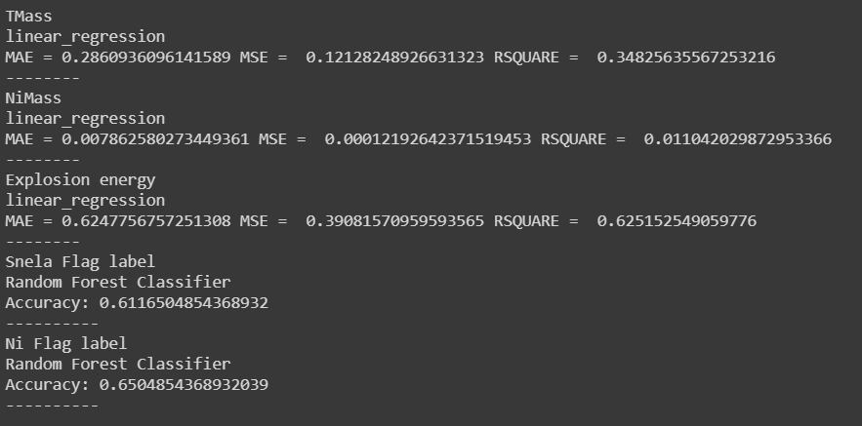
Accuracy of all the different models that were trained.
The accuracy for Random forest Classifier is low and Rsquared value for linear regression are high, mainly the reason behind is that the amount of data given is quite low, as the amount of data increases these uncertainty will surely decrease.

Slide 12
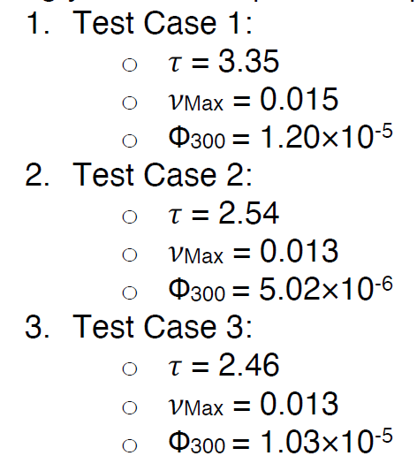
 | Total Mass | Initial Ni Mass | Explosion Energy | Snela Mass distribution Flag | Ni Mass distribution Flag
Case1 | 2.041665355 | 0.630932517 | 1.380245037 | N100 | mwd
Case2 | 1.5148545 | 0.261369474 | 1.362017921 | hed8 | hed8
Case3 | 1.392440847 | 0.5452576 | 1.380180445 | hed8 | w7dt
These are the values which are obtained for the cases given:

Slide 13
The Jupyter Notebook can be accessed through :
https://github.com/VIDIT-OSTWAL/GSoC---2021-ML4SCI/blob/main/Supernova.ipynb
Some glance of my code:
Linear_regression_comparision function : This function returns a set of five models, 3 of regression type and two of classification type, the input is the dataset, all the required columns are extracted within the function itself.
Physical_parameters_value : This function directly return a data frame, which has all the predicted physical parameters, the input is a data frame containing observable values.
LOOKING FORWARD TO WORK WITH YOU!

